Slide 1
Computer Organization
B.Tech.II CSE (Sem-3)

Slide 2
Topics
Components of Computer
Structure & Function of Computer
The Computer Level Hierarchy
The Von Neumann Model
Moore’s Law
Terminology

Slide 3
Components of a Computer
Input (mouse, keyboard, …)
Output (display, printer, …)
Memory
  Main (DRAM), Cache (SRAM)
  Secondary (Disk,CD, DVD, …)
Datapath
Control
Input
Processor
(CPU)
Output
Processor
Control
Memory
1001010010110000
0010100101010001
Datapath
1111011101100110
1001010010110000
1001010010110000
1001010010110000

Slide 4
Structure & Function of Computer
At the most basic level, a computer is a device consisting of :
  A processor to interpret and execute programs
  A memory to store both data and programs
  A mechanism for transferring data to and from the outside world (Input/Output)
Structure is the way in which components relate to each other
Function is the operation of individual components as part of the structure

Slide 5
Structure - Top Level
Peripherals
Computer
Central
Processing
Unit
Main
Memory
Computer
Systems
Interconnection
Input
Output
Communication
lines

Slide 6
Structure - The CPU
CPU
Computer
Arithmetic
and
Login Unit
I/O
Registers
System
Bus
CPU
Internal CPU
Interconnection
Memory
Control
Unit

Slide 7
Structure - The Control Unit
Control Unit
CPU
Sequencing
Login
ALU
Internal
Bus
Control
Unit
Control Unit
Registers and
Decoders
Registers
Control
Memory

Slide 8
Computer Functions
Data processing
Data storage
Data movement
Control

Slide 9

Functional view

Slide 10

Operations (1) Data movement
Simply transferring data from one peripheral or communications line to another.

Slide 11
Operations (2) Storage
Data transferred from the external environment to computer storage (read) and vice versa (write).

Slide 12
Operation (3) Processing from/to storage

Slide 13
Operation (4)
Processing from storage to I/O

Slide 14
The Computer Level Hierarchy
Writing complex programs requires
  A “divide and conquer” approach, where each program module solves a smaller problem
Complex computer systems employ a similar technique through a series of virtual machine layers

Slide 15
Six
Level Computer
LEVEL 5
Problem Oriented Language Level
(High Language Level)
Translation(Compiler)
LEVEL 4
Assembly Language Level
Translation(Assembler)
LEVEL 3
Operating System Machine Level
Partial Interpretation
(Operating System)
LEVEL 2
Instruction Set Architecture Level
Interpretation (Microprogram) /
Direct Execution (Hardwired)
LEVEL 1
Micro Architecture Level
Hardware
LEVEL 0
Digital Logic Level

Slide 16
The Computer Level Hierarchy
Level 5: Problem Oriented (High-Level) Language Level
  Program execution and user interface level
  The level with which we are most familiar
  The level with which we interact when we write programs in languages such as C, Pascal, Lisp, and Java
Level 4: Assembly Language Level
  Acts upon assembly language produced from Level 5, as well as instructions programmed directly at this level
Level 3: Operating System Machine (System Software) Level
  Controls executing processes on the system
  Protects system resources
  Assembly language instructions often pass through Level 3 without modification

Slide 17
The Computer Level Hierarchy
Level 2: Instruction Set Architecture (ISA) Level
  Also known as the Machine Level
  Consists of instructions that are particular to the architecture of the machine
  Programs written in machine language need no compilers, interpreters, or assemblers

Slide 18
The Computer Level Hierarchy
Level 1: Control Level
  A control unit decodes and executes instructions and moves data through the system
  A collection of 8 to 32 registers form a local memory and a circuit called an ALU capable of performing simple arithmetic operations are present
  The registers are connected to the ALU to form a data path over which data flow
  On some machines the operation of the data path is controlled by a program called a microprogram – microprogrammed CU
    A microprogram is a program written in a low-level language that is implemented by the hardware
  On other machines the data path is controlled directly by hardware – hardwired CU
    Hardwired control units consist of hardware that directly executes machine instructions

Slide 19
The Computer Level Hierarchy
Level 0: Digital Logic Level
  Where find digital circuits (the chips)
  Digital circuits consist of gates and wires
    Each gate has one or more digital inputs and computes some simple function of the inputs such as AND or OR
  These components implement the mathematical logic of all other levels
  A small number of gates can be combined to form a 1-bit memory, 1-bit memories can be combined to form 16, 32, or 64 bit registers which can hold a single binary number

Slide 20
Basic Computer Model
The von Neumann Model

Slide 21
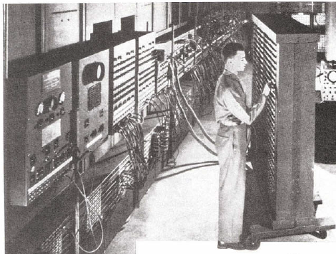
Why The Von Neumann Model ?
On the ENIAC, all programming was done at the digital logic level
Programming the computer involved moving plugs and wires
Configuring the ENIAC to solve a “simple” problem required many days labor by skilled technicians
A different hardware configuration was needed to solve every unique problem type

Slide 22
The von Neumann Model
The invention of stored program computers has been ascribed by a mathematician, John von Neumann
Stored-program computers have known as von Neumann Architecture systems

Slide 23
The von Neumann Model
Stored-program computers have the following characteristics:
  Three hardware systems:
    A central processing unit (CPU)
    A main memory system
    An I/O system
  Provides the capacity to carry out sequential instruction processing

Slide 24
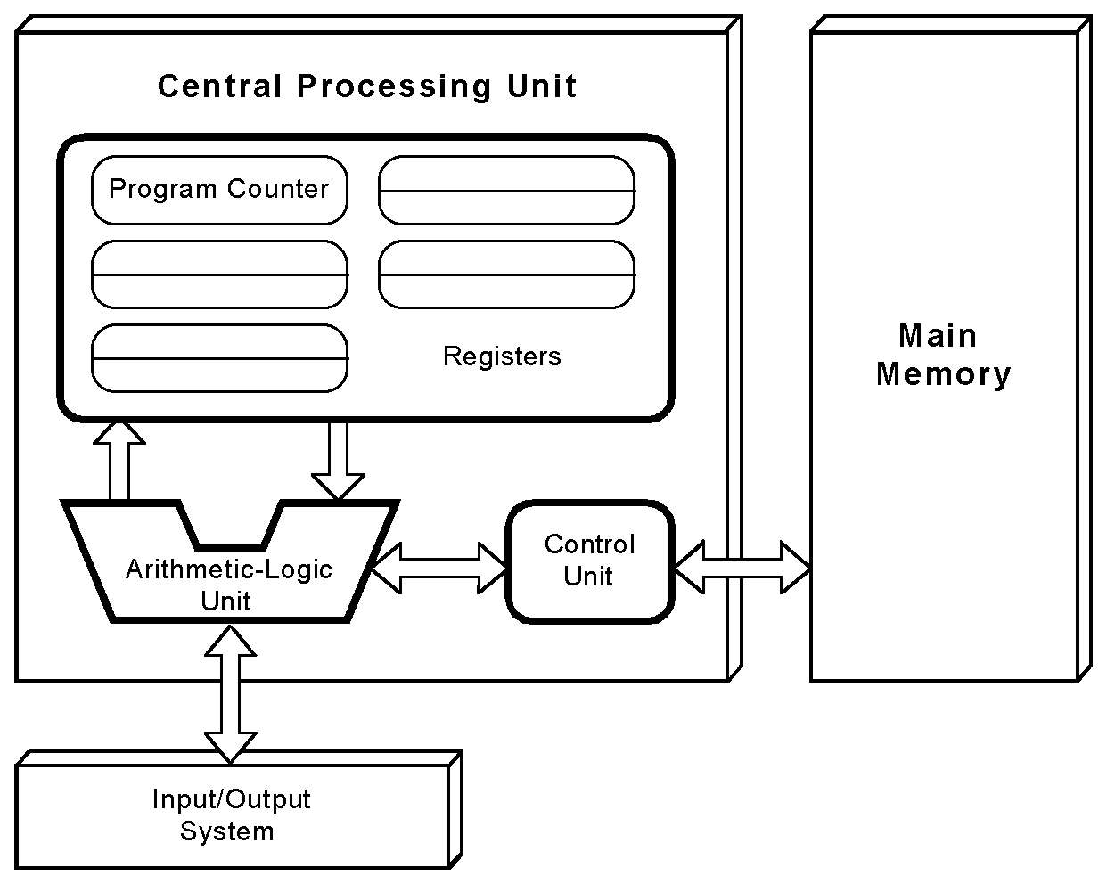
The von Neumann Model
Computers employ a fetch-decode-execute cycle to run programs

Slide 25
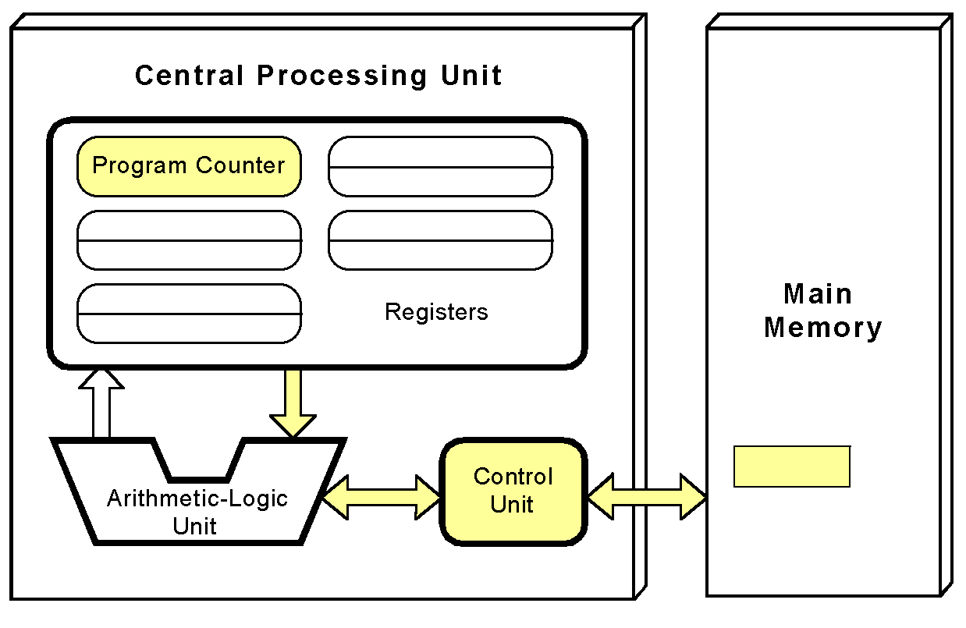
The von Neumann Model
The control unit fetches the next instruction from memory using the program counter to determine where the instruction is located

Slide 26
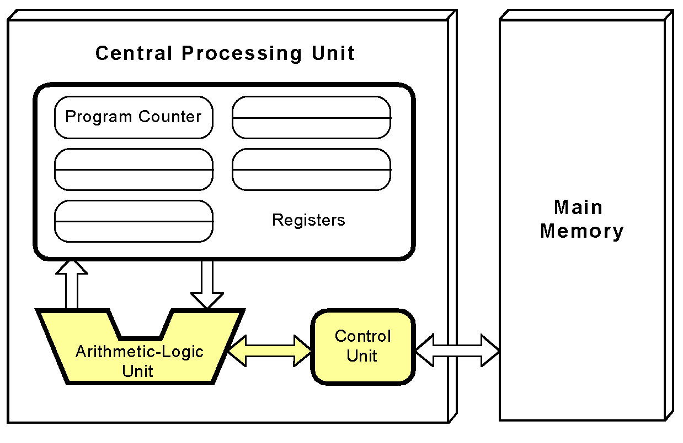
The von Neumann Model
The instruction is decoded into a language that the ALU can understand

Slide 27
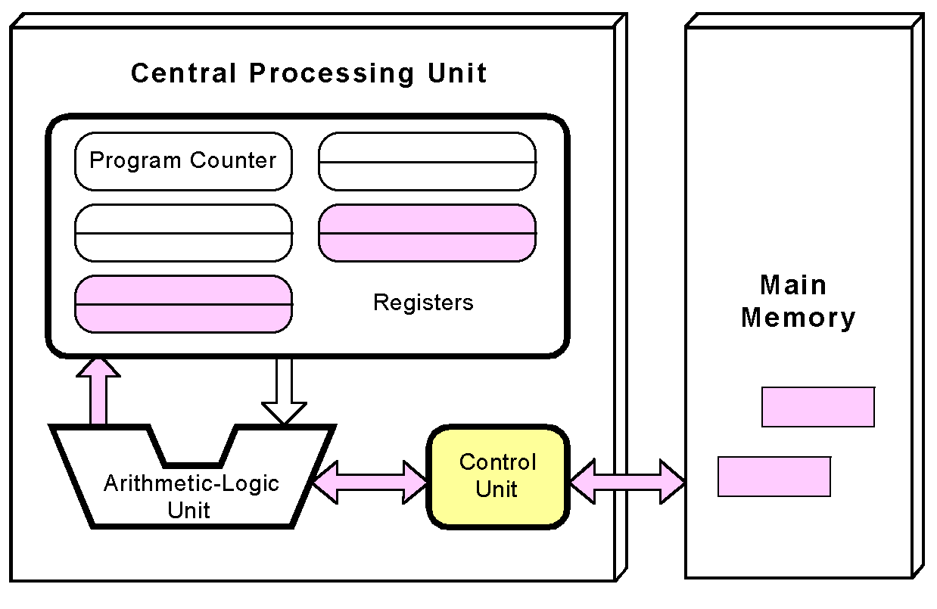
The von Neumann Model
Any data operands required to execute the instruction are fetched from memory and placed into registers within the CPU

Slide 28
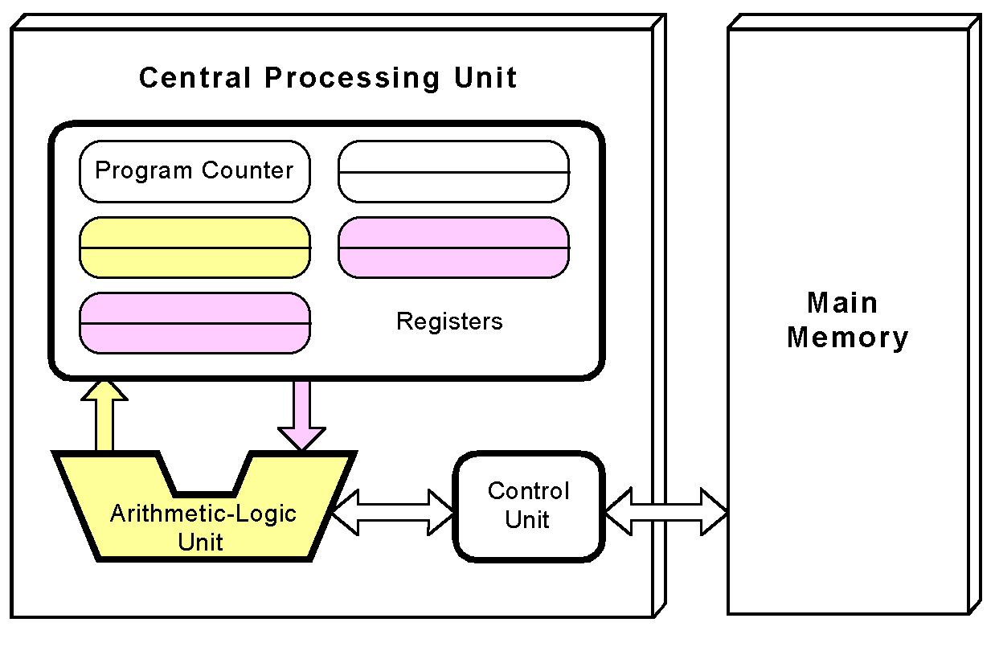
The von Neumann Model
The ALU executes the instruction and places results in registers or memory

Slide 29
The von Neumann Model
Used the system bus
  Data bus moves data from main memory to the CPU registers (and vice versa)
  Address bus holds the address of the data that the data bus is currently accessing
  Control bus carries the necessary control signals that specify how the information transfer is to take place

Slide 30

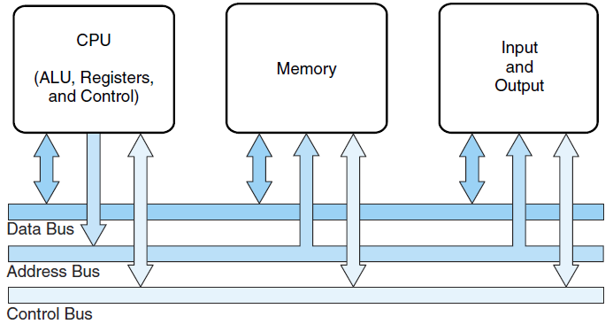
The von Neumann Model

Slide 31
The von Neumann Model
A single data path between the CPU and main memory
  This single path is known as the von Neumann bottleneck

Slide 32
Today’s-von Neumann Models
With many incremental improvements over the years:
  Adding specialized buses
    Programs and data stored in a slow-to-access storage medium, such as a HD, can be copied to a fast-access, volatile storage medium such as RAM prior to execution.
      This architecture called the system bus model.
        The data bus moves data from main memory to the CPU registers (and vice versa).
        The address bus holds the address of the data that the data bus is currently accessing.
        The control bus carries the necessary control signals that specify how the information transfer is to take place.
  Use of index registers addressing
  Floating-point units
  Cache memories
  Use of interrupts
  Asynchronous I/O
  Concept of Virtual Memory
  …

Slide 33
von Neumann Models
Sufficient?
  No, Computational power require departure from the classic von Neumann architecture

Slide 34
Non-von Neumann Models
Adding processors is one approach
  In the late 1960s, high-performance computer systems were equipped with dual processors to increase computational throughput
In the 1970s supercomputer systems were introduced with 32 processors
Supercomputers with 1,000 processors were built in the 1980s
In 1999, IBM announced its Blue Gene system containing over 1 million processors

Slide 35
Non-von Neumann Models
Parallel processing is only one method of providing increased computational power
DNA computers, quantum computers and dataflow systems
  May be the basis for the next generation of computers

Slide 36
Moore’s Law
Rapidly changing field:
  Vacuum tube -> Transistor -> IC -> VLSI
  Memory capacity
  Processor speed (due to advances in technology and hardware organization)

Slide 37
Moore’s Law
In 1965 by Gordon Moore, Intel founder
  “The density of transistors in an integrated circuit will double every year.”
Contemporary version:
  “The density of silicon chips doubles every 18 months.”
Notes:
Contemporary version is the current trend…

Slide 38
Next
ISA

Slide 39
Terminology

Slide 40
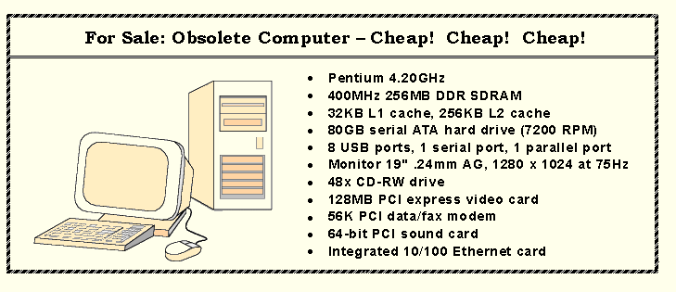
An Example System
Consider this advertisement:
MHz??
MB??
L1 Cache??
PCI??
USB??
Check the latest one… and understand what does it all mean??

